Slide 1
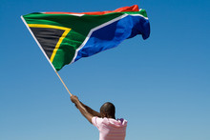
“Nothing About Us, Without Us”
Transforming Spinal Cord Injury Care Through Meaningful Participation
Presented by Gail Baerecke
Dr Ailey Key Memorial Presentation
SASCA Conference, Cape Town
May 22, 2025
G
Notes:
Good morning everyone, and thank you for being here today. It is a privilege to speak to you at the South African Spinal Cord Association Conference, and no occasion could be more fitting to honour the legacy of Dr Ailey Key - a true pioneer in the rehabilitation of individuals with spinal cord injuries in South Africa. Dr Key, alongside Dr Mitty Retief, co-founded the Spinal Injury Unit at Conradie Hospital, Cape Town in 1963 and led the unit with distinction from 1971 to 1985. Her unwavering ambition was to ensure that people with spinal injuries received the highest standard of care and rehabilitation, empowering them to reclaim their place in family life, the workplace, and society. Through skills developed in hospital and rehabilitation centres, she believed in enabling individuals to live lives of dignity, purpose, and meaning. With this brief tribute to an extraordinary woman and her pioneering vision, I am honoured to introduce my topic today: "Nothing About Us, Without Us: Transforming Spinal Cord Injury Care Through Meaningful Participation." I will focus on the critical importance of including the voices and perspectives of people living with spinal cord injuries in the design and delivery of healthcare services and policy. Over the next half hour, I'll be sharing insights, best practices, and personal stories that demonstrate how meaningful inclusion can lead to more effective, equitable, and person-centered care. Let's dive in.

Slide 2
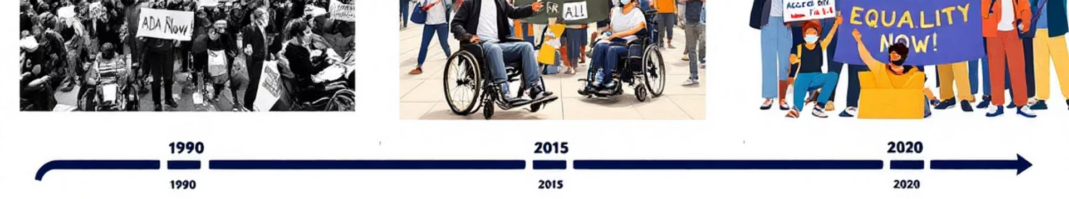
Historical Context & Origin
1
2
3
4
1990s
1994
1994
1998
Phrase originated within the global disability rights movement
South African democratic transition aligns disability rights with human rights agenda
SASCA established to advance spinal cord injury care
James Charlton's book "Nothing About Us Without Us" brings global prominence
Notes:
This slogan NOTHING ABOUT ME, WITHOUT ME has an interesting origin and fits nicely into the history of South Africa. During the 1990's the term was adopted into disability activism circles. James Charlton an American author and disability rights activists documented that he first heard the term in talks with South African disability activists 1994 was big year for South Africa. After many years of apartheid, our country went through a robust democratic transition, disbility rights were aligned with human rights and SASCA was established In 1998, James Charlton used the saying/slogan as a title for his book on disability rights. In 2004, the United Nations used the phrase as the theme of the International Day of Persons with Disabilities.

Slide 3

Advancing the Message
No Decisions Without Our Voices
Emphasizes the critical importance of representation in decision-making processes
Lead With Us, Not For Us
Challenges traditional power dynamics in healthcare relationships
Inclusion Is Not Optional
Positions participation as a fundamental right rather than a courtesy
Design With Us In Mind
Focuses on incorporating lived experience into systems and solutions
Notes:
With Ai being so topical at the moment, I asked ChatGPT to provide some alternative slogans that convey a similar message of inclusion, representation, and participatory decision-making, while offering a fresh take on the original phrase "Nothing about us, without us": It came up with these: 1. NO DECISIONS WITHOUT OUR VOICES - Emphasizes the need for those affected to be actively involved in decision-making. 2. LEAD WITH US, NOT FOR US - Encouraging collaboration rather than top-down control 3. INCLUSION IS NOT OPTIONAL - Highlights that participation and representation are a necessity, not a courtesy. 4. DESIGN WITH US IN MIND - Focuses on intentional inclusion in policy, design, or any change processes.

Slide 4





Core Meaning & Philosophy
Participatory Decision-Making
Expertise Through Experience
Decisions impacting a group must include the full participation of that group
People with disabilities are the true experts in their own lives and needs
Beyond The Medical Model
Upholding Core Values
Decisions made with individuals rather than for them
Dignity, autonomy, and the right to self-determination
Notes:
So how can we break down its Core Meaning & Philosphy in the context of spinal cord injuries? PARTICIPATORY DECISION-MAKING: At its heart, the phrase affirms that decisions impacting a group must include the full participation of that group. EXPERTISE THROUGH EXPERIENCE: It recognizes that people with disabilities are the true experts in their own lives, experiences, and needs. BEYOND THE MEDICAL MODEL: It stands in contrast to the traditional medical model, which made decisions for individuals rather than with them. UPHOLDING CORE VALUES: It upholds the values of dignity, autonomy, and the right to self-determination.

Slide 5








Application In Spinal Cord Injury Context
Active Involvement in Care
Lived Experience as Expertise
Patients shape their own treatment plans and rehabilitation goals
Firsthand insights guide research, service design, and policy
Identifying Gaps Through Patient Insight
Power of Peer Support
Mentorship fosters hope, motivation, and practical guidance
Patient perspectives highlight unmet needs in service delivery
Notes:
Let's look at some suggestions for applying these elements within the Spinal Cord Injury Context 1. Active Involvement in Care As far as possible, allow your patients to play a vital role in their own treatment plans and rehabilitation goals. 2. Lived Experience as Expertise: The firsthand insights of people with spinal cord injuries shape research, drive service design, and influence policy – turning experience into leadership. Having the invaluable "at the coalface" experience also can provide numerous teaching opportunities for educating healthcare professionals in training. 3. Identifying Gaps Through Patient Insight: A patients perspective on how things are and can be done, helps us as therapists to better understand unmet needs and areas for improvement in the treatment and services we delivery. 4. Power of Peer Support: One cannot underestimate the power of Peer Support for providing a sense of belonging, reducing isolation, depresion and anxiety, increasing confidence and motivation, and practical knowledge and resources as well as helping to bridge cultural, language and social gaps in traditional care.

Slide 6





Practical Implementation
Embedding Patient Voice
Structured methods for involving patients in treatment planning
Inclusive Research Practices
Engage individuals as partners in research design and evaluation
Integrating Lived Experience
Incorporate patient insights into medical education and training
Collaborative Goal-Setting
Promote shared decision-making in rehabilitation planning
Notes:
Here are some suggestions for implementing these elements 1. Embedding Patient Voice in Care: Make sure patients have a say about their care, encourage their voices and opinions, provide a safe non-judgemental environment for them to express themselves and make sure you hear what they have to say, 2. Inclusive Research Practices: South African research on spinal cord injuries is crucial for advancing global understanding of the condition, designing helpful solutions, and improving the lives of people with SCIs in both developing and developed countries, hence the opportunity to work together with ones patients to also help plan, carry out and review research 3. Integrating Lived Experience into Training: Include patient stories and experiences in how to train future healthcare workers. Teach with patients, not just about them. 4. Collaborative Care and Goal-Setting: Work side by side to set recovery goals that truly matter to the patient and that fit their lives.

Slide 7
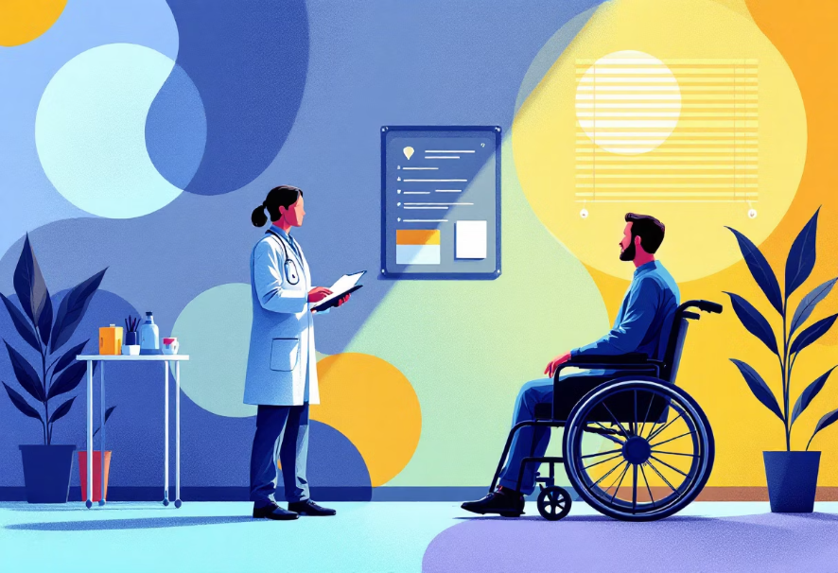

Challenges and Barriers
Power Dynamics
Knowledge Gaps
Traditional hierarchies limit meaningful patient participation in decision-making
Differences between clinical expertise and lived experience hinder mutual understanding
Notes:
Like with any systems and processes, there are always CHALLENGES AND BARRIERS that often cause a breakdown in collaboration 1. Power Dynamics in Healthcare: Old fashion power structures make it hard for patients to take part in important decisions about their care. EXAMPLE: A patient with a spinal cord injury is admitted to a rehabilitation unit. The medical team develops a treatment plan focusing primarily on physical therapy to improve mobility. However, the patient wishes to prioritise working on his/her independence in daily activities like dressing and toileting, which they feel would improve their quality of life more immediately. Despite voicing this, the team proceeds with the original plan, assuming they know what’s “best” from a clinical standpoint. The patient feels unheard and disengaged from their care. This demonstrates how traditional hierarchies—where healthcare professionals make decisions for patients rather than with them—can marginalize the patient’s voice and reduce the relevance and effectiveness of the rehabilitation process. 2. Bridging Knowledge Gaps: Differences between what has been taught in ones’ medical training and real-life patient experiences can make it hard to fully undestand each other. EXAMPLE: A therapist recommends a specific wheelchair setup based on taught clinical guidelines to support posture and prevent pressure sores. From a medical standpoint, it’s the “optimal” configuration. However, the patient finds the setup too bulky and difficult to manoeuvre in their home, particularly through narrow doorways and in their small bathroom. When the patient raises this concern, the therapist initially dismisses it, emphasising clinical safety over comfort and practicality. The patient feels misunderstood and frustrated, while the clinician is puzzled by the patient’s resistance. This highlights how differences between clinical expertise (focused on medical outcomes) and lived experience (focused on real-world usability and daily function) can create disconnects in care if both perspectives aren't equally valued.

Slide 8
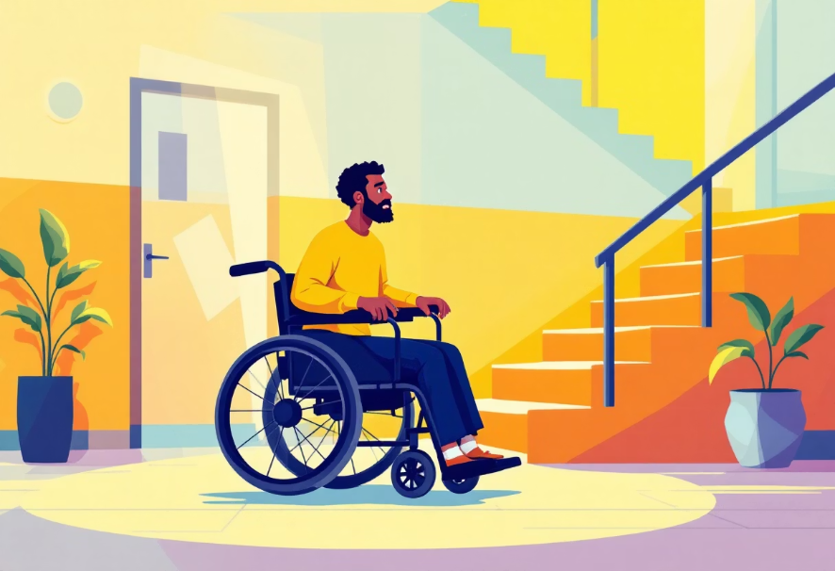

Challenges and Barriers
Practical Barriers
Diverse Voices
Physical accessibility, time constraints, and limited resources impede full involvement
Balancing varied needs within the disability community requires sensitivity
Notes:
3. Practical Barriers to Inclusion: Problems like hard to reach locations, not enough time allocated to discussion, and limited resources can make it difficult for people to fully take part. EXAMPLE: A multidisciplinary care planning meeting is scheduled to discuss the rehabilitation goals for a particular patient. The meeting is held in a boardroom on the second floor of the rehab centre but the elevator is out of service. The patient, who uses a wheelchair, is therefore unable to attend. Or the meeting is scheduled during therapy hours, and the therapists are pressed for time. As a result, the discussion is rushed, and the patient’s views are relayed second-hand rather than heard directly. Family members of patients from rural areas included in their care, face transport, financial and accommodation considerations. This example shows how physical inaccessibility, time constraints, staffing limitations and family social dynamics can exclude patients from actively participating in decisions about their own care. 4. Navigating Diverse Voices: Meeting the different needs and views in the disability community takes understanding and flexibilty. EXAMPLE: A rehabilitation center is designing a new patient feedback program to improve services. During consultations, some patients request more peer support groups, while others - particularly those with high-level injuries - emphasize the need for improved home-based care and access to equipment. Younger patients push for digital communication tools, while older patients prefer face-to-face interactions and printed materials. Other NB considerations are language translations and levels of education. Trying to meet all these preferences proves challenging. When staff realise that one approach won’t suit everyone, it becomes NB to offer flexible choices, like virtual or in-person peer support and to peronalise follow-up care based on what each person needs. This example shows that the disability community is not a monolith. Effective inclusion means listening to a spectrum of voices and being willing to adapt services to reflect that diversity.

Slide 9
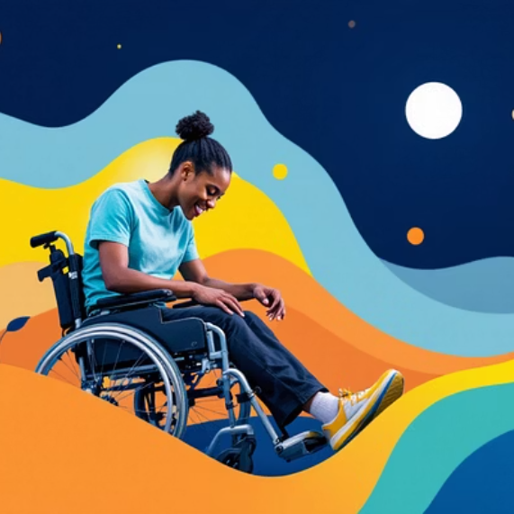


Success Stories
Improved Outcomes
Innovative Programs
South African initiatives embracing patient participation
Patient-involved treatment plans show higher success rates
Notes:
LET'S LOOK AT SOME SUCCESS STORIESWHERECOLLABORATION, INCLUISION AND PARTICIPATION HAS TAKEN PLACE 1. Improved Outcomes: A collaborative approach to patient involvement in their treatment plans improves outcomes and has a higher rate of success, progress at regaining independence is faster, he/she feels more empowered and motivated throughout the process, leading to improved mental health and overall well-being. 2. Innovative Programs Embracing the "Nothing About Us, Without Us" Principle: I will highlight just two such examples of great collaboration implemented here in South Africa in my final two slides demonstrating the benefits of including patient perspectives in the delivery of healthcare delivery. .

Slide 10

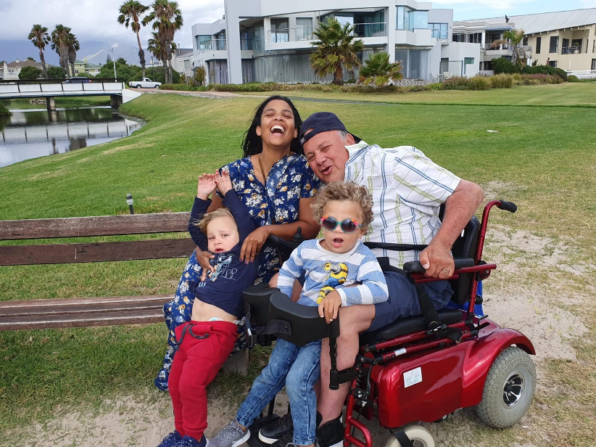
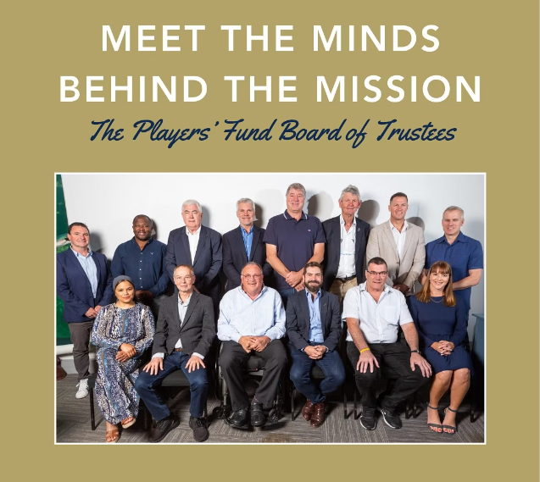
1st South African example:
The Chris Burger Petro Jackson Players’ Fund
ANTON ENGELBRECHT
C5 Quadriplegic
A husband and father of twin boys
A business Development consultant in Cape Town
Notes:
Read these notes first and then the slide notes. The Chris Burger Petro Jackson Players’ Fund is a respected South African non-profit and the official charity of the Springboks, who have been supporting rugby players who have sustained life-changing injuries whilst playing rugby since 1980. In 2011, one of their recipient Anton Engelbrecht was invited to join the board of trustees of the Players’ Fund. Anton had been a Fund recipient following a devastating spinal cord injury whilst playing university rugby in the 1980s. Anton is a C5 quadriplegic, a husband and father of twin boys and works as a business development consultant for a financial services company in Cape Town. Anton has brought valuable firsthand insight to the board and staff members and has helped them better understand the needs of each of the recipients based on their individual circumstances, their requests made for specialized equipment, repairs and maintenance thereof. He has helped develop research questions utilized by previous PhD students working with the Players’ Fund and was instrumental in contributing significantly to the quality-of-life surveys used during annual recipient visits. His inclusion has without a doubt, enhanced the Fund’s transparency of ensuring player welfare remains central to its mission.

Slide 11
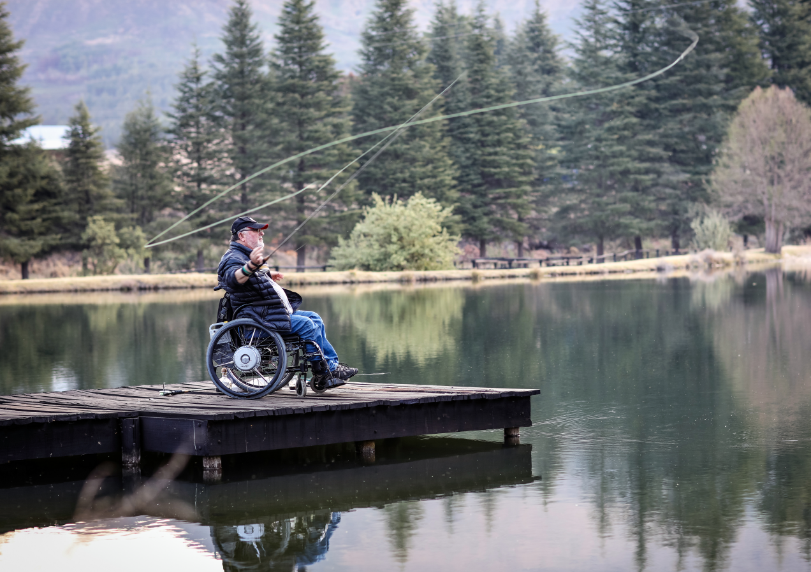

2nd South African example:
The QuadPara Association of South Africa
ARI SEIRLIS
C4 quadriplegic
Former CEO of the QuadPara Assocation of SA
Fly-fisherman
Advocate for disability rights
Grassroots activist
Notes:
The 2nd South African example is that of the QuadPara Association of South Africa (QASA) who is considered the leading agency representing persons with spinal cord injury and physical disability in South Africa. QASA is a NPO of Quadriplegics and Paraplegics. QASA strives to develop products, programmes and services in order to develop capacity amongst its members and to offer opportunities for societal integration.
It is under this banner that I introduce a formidable human being Ari Seirlis – former CEO of QASA who has dedicated his life advocating for disability rights It is difficult to summarise the significant contribution Ari has made to creating a more inclusive and equitable society for those living with a disability in South Africa, but I will touch on a few. As a person living with a disability himself and former CEO of the QuadPara Association of SA, over the decades, Ari has had a seat at many “round tables at the highest level in this country, he has made his voice heard and as a result has shaped national disability and rehabilitation policy, as well as the formation of the disability act. His grassroots activism has resulted in more accessible public transportation in South Africa and universal disability design principles in urban planning, He is the epitome of the slogan , Nothing about us, Without Us.

Slide 12








Future Directions
True Partnership
Moving beyond tokenism to equitable patient-professional relationships
Patients at the Heart
Design sustainable systems for patients
Technology Integration
Digital tools enabling wider and more accessible patient involvement
Shared decision-making Models
Collaborative approaches between patients and providers in all care stages
Notes:
SO IN CONCLUDING - HOW DO WE LOOK TO THE FUTURE? New Models of Co-Production in HealthcareTalking notes: Find approaches that foster collaboration between patients and healthcare providers in all stages of care. Example: A hospital develops a collaborative care model where patients with spinal cord injuries actively participate in the design of their rehabilitation programs. They work alongside clinicians to choose therapeutic interventions and set realistic goals. This co-production model ensures that the patient's individual preferences and experiences shape the care they receive, resulting in a more personalized and effective rehabilitation process. The Role of Technology in Enhancing ParticipationTalking notes: Look to using digital tools to enable wider and more accessible patient involvement. Example: A mobile app is developed to help patients where spinal cord injuries track their rehabilitation progress and communicate directly with their healthcare team. The app includes features for patients to provide feedback on their treatment plans, participate in virtual support groups, and share their experiences with other patients. Technology allows patients to have a continuous voice in their care, even outside of formal appointments. Creating Sustainable Systems for Ongoing InvolvementTalking notes: Try and develop frameworks that ensure continuous patient engagement in healthcare processes. Example: A spinal cord injury association establishes an advisory board made up of patients, caregivers, and healthcare providers. This board meets regularly to review and update rehabilitation protocols, ensuring that patient feedback is continually incorporated into care strategies. The board structure allows for long-term, sustainable patient involvement in healthcare decision-making and policy development. From Tokenism to True PartnershipTalking notes: Move beyond symbolic participation to create genuine, equitable partnerships between patients and healthcare professionals. Example: A rehabilitation center shifts from conducting patient satisfaction surveys (a common form of token involvement) to implementing patient-led committees that participate in decision making regarding new services or facility improvements. In these committees, patients are not just asked for feedback-they are given decision-making power, such as determining which new technologies or support programs should be introduced at the facility.

Slide 13




Moving Forward Together
Patient participation isn't just ethical—it's essential for effective healthcare.
The "Nothing About Us, Without Us" philosophy creates more responsive, compassionate care systems.
Build True Partnerships
Amplify Diverse Voices
Create sustainable frameworks that embed patient voices at every level.
Ensure representation from all affected communities.
Commit to the Journey
Patient involvement is continuous, not a one-time consultation.

Slide 14

Thank You
Your commitment to patient-centered care helps build a healthcare system where "Nothing About Us, Without Us" becomes reality.
Together, we're creating a world where every voice is valued and represented.
If you want to go fast, go alone. If you want to go far, go together.
AFRICAN PROVERB
Notes:
I often remind myself of an old African Proverb……If you want to go fast, go alone. If you want to go far, go together. So let each of us here today review how we do things, introduce collaboration, inclusivity, flexibility, remove disconnection, allow full participation in all places and spaces and by doing so, let’s contribute to the development of truly inclusive societies.

